Slide 1
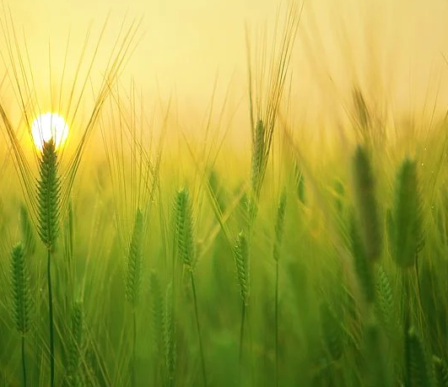
FARMatrix

Slide 2

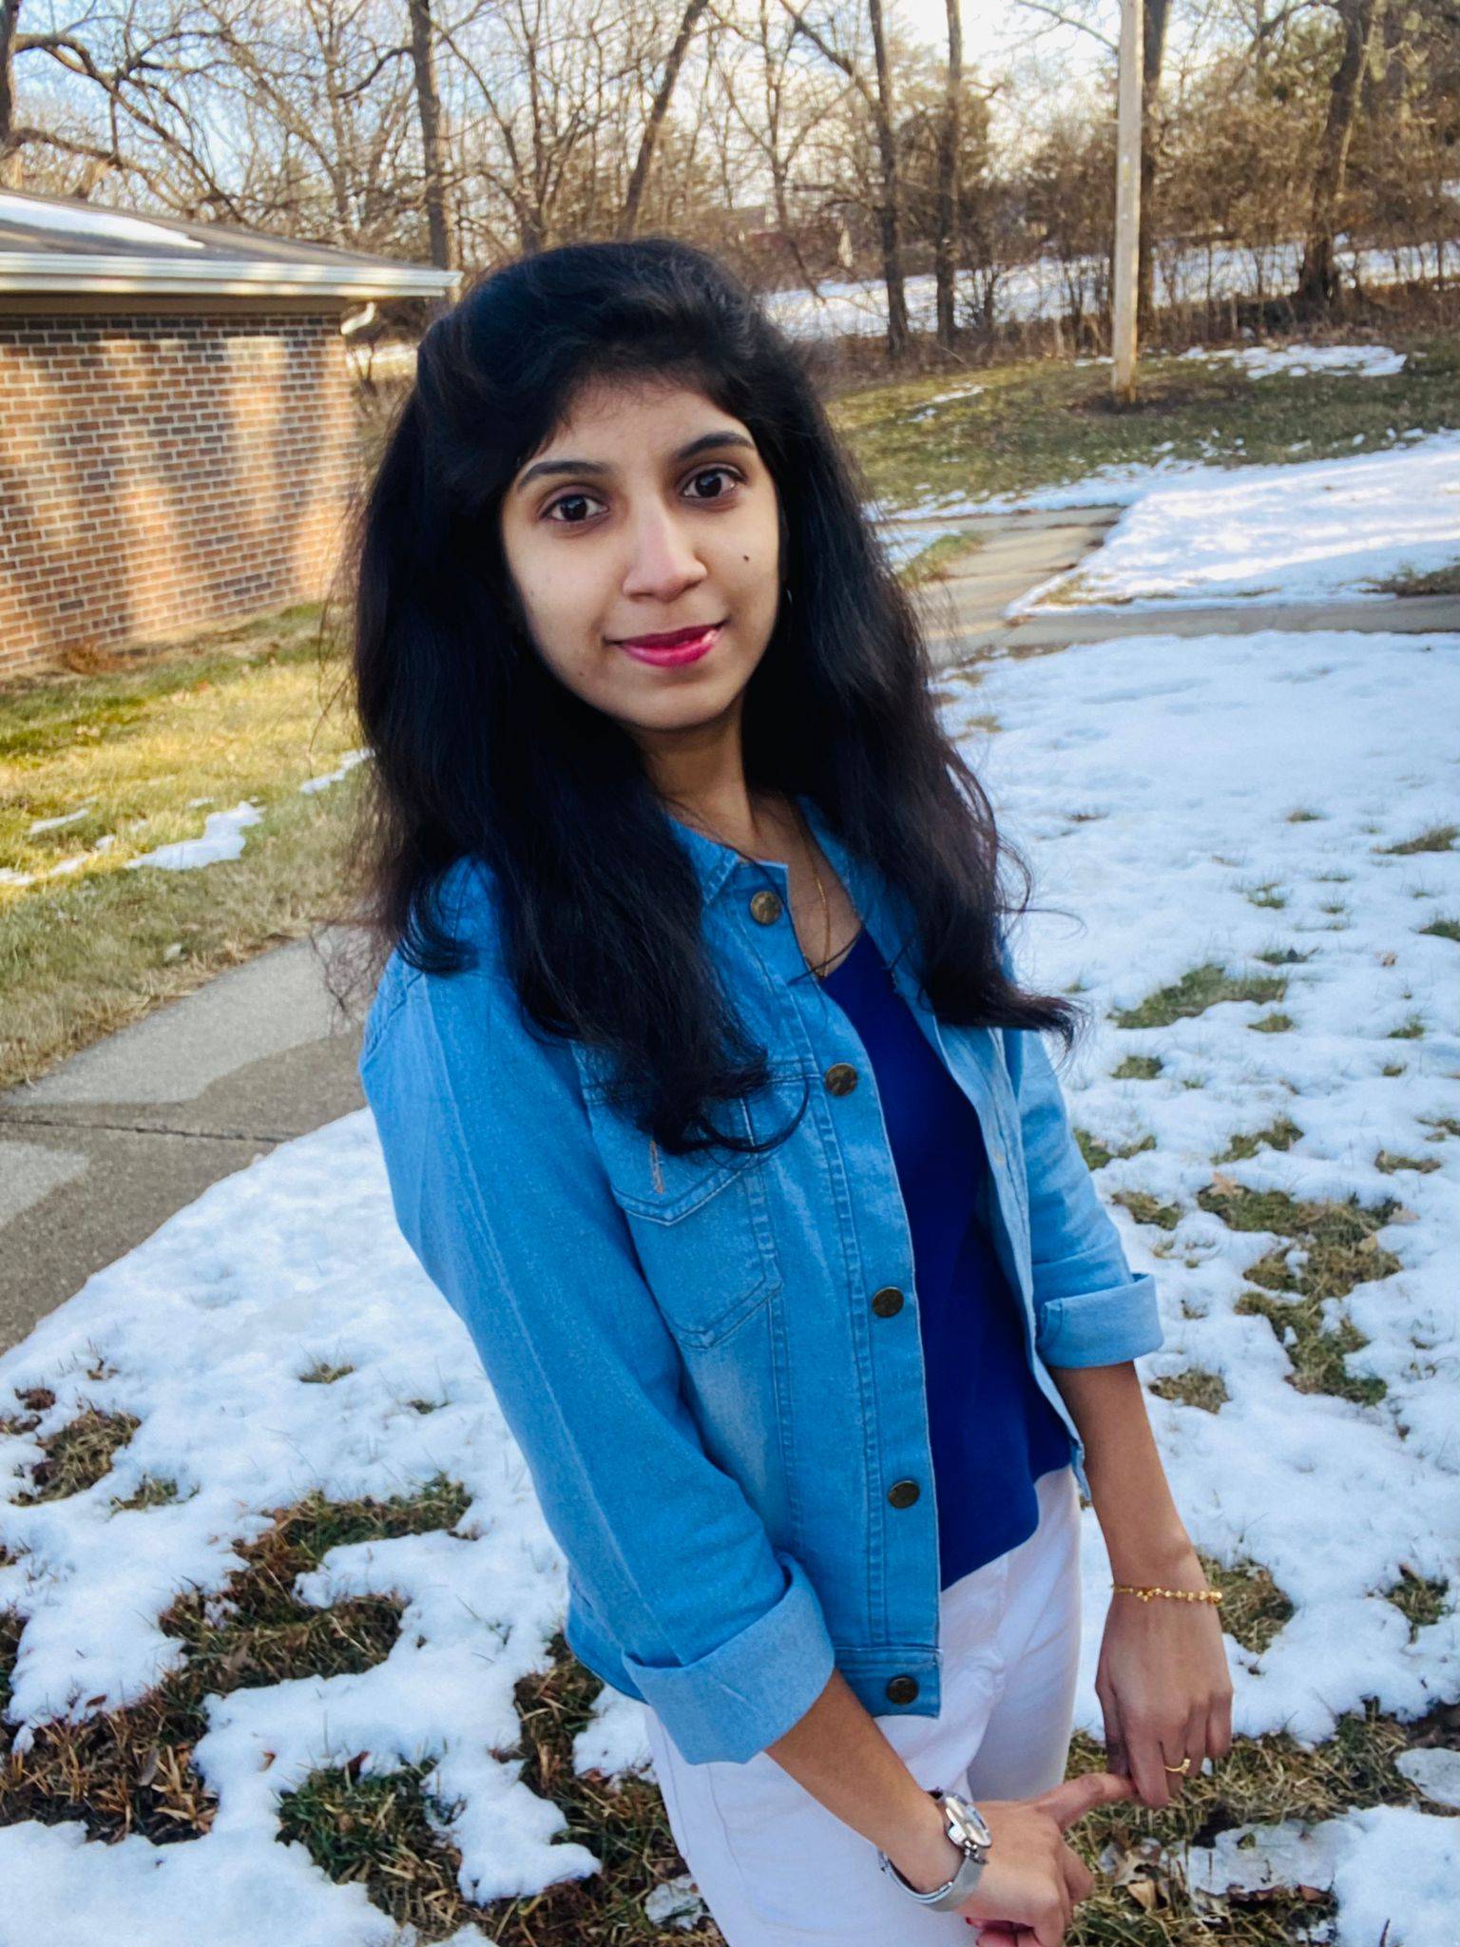
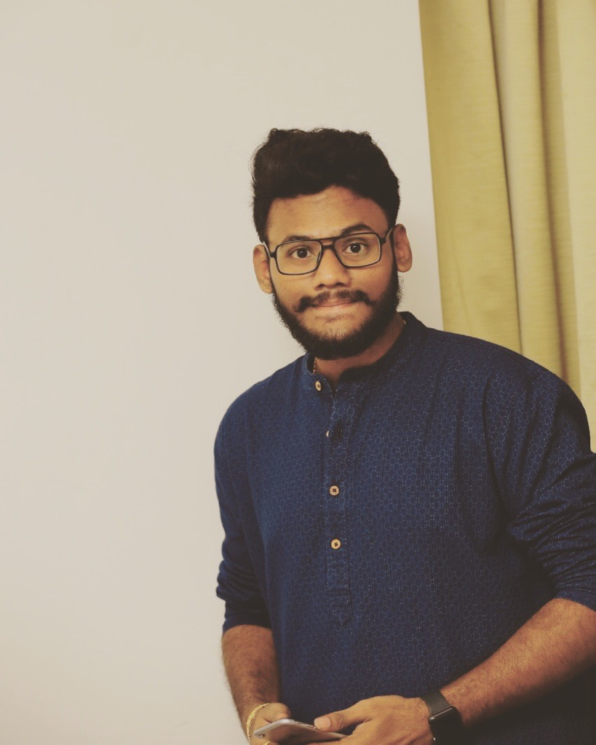
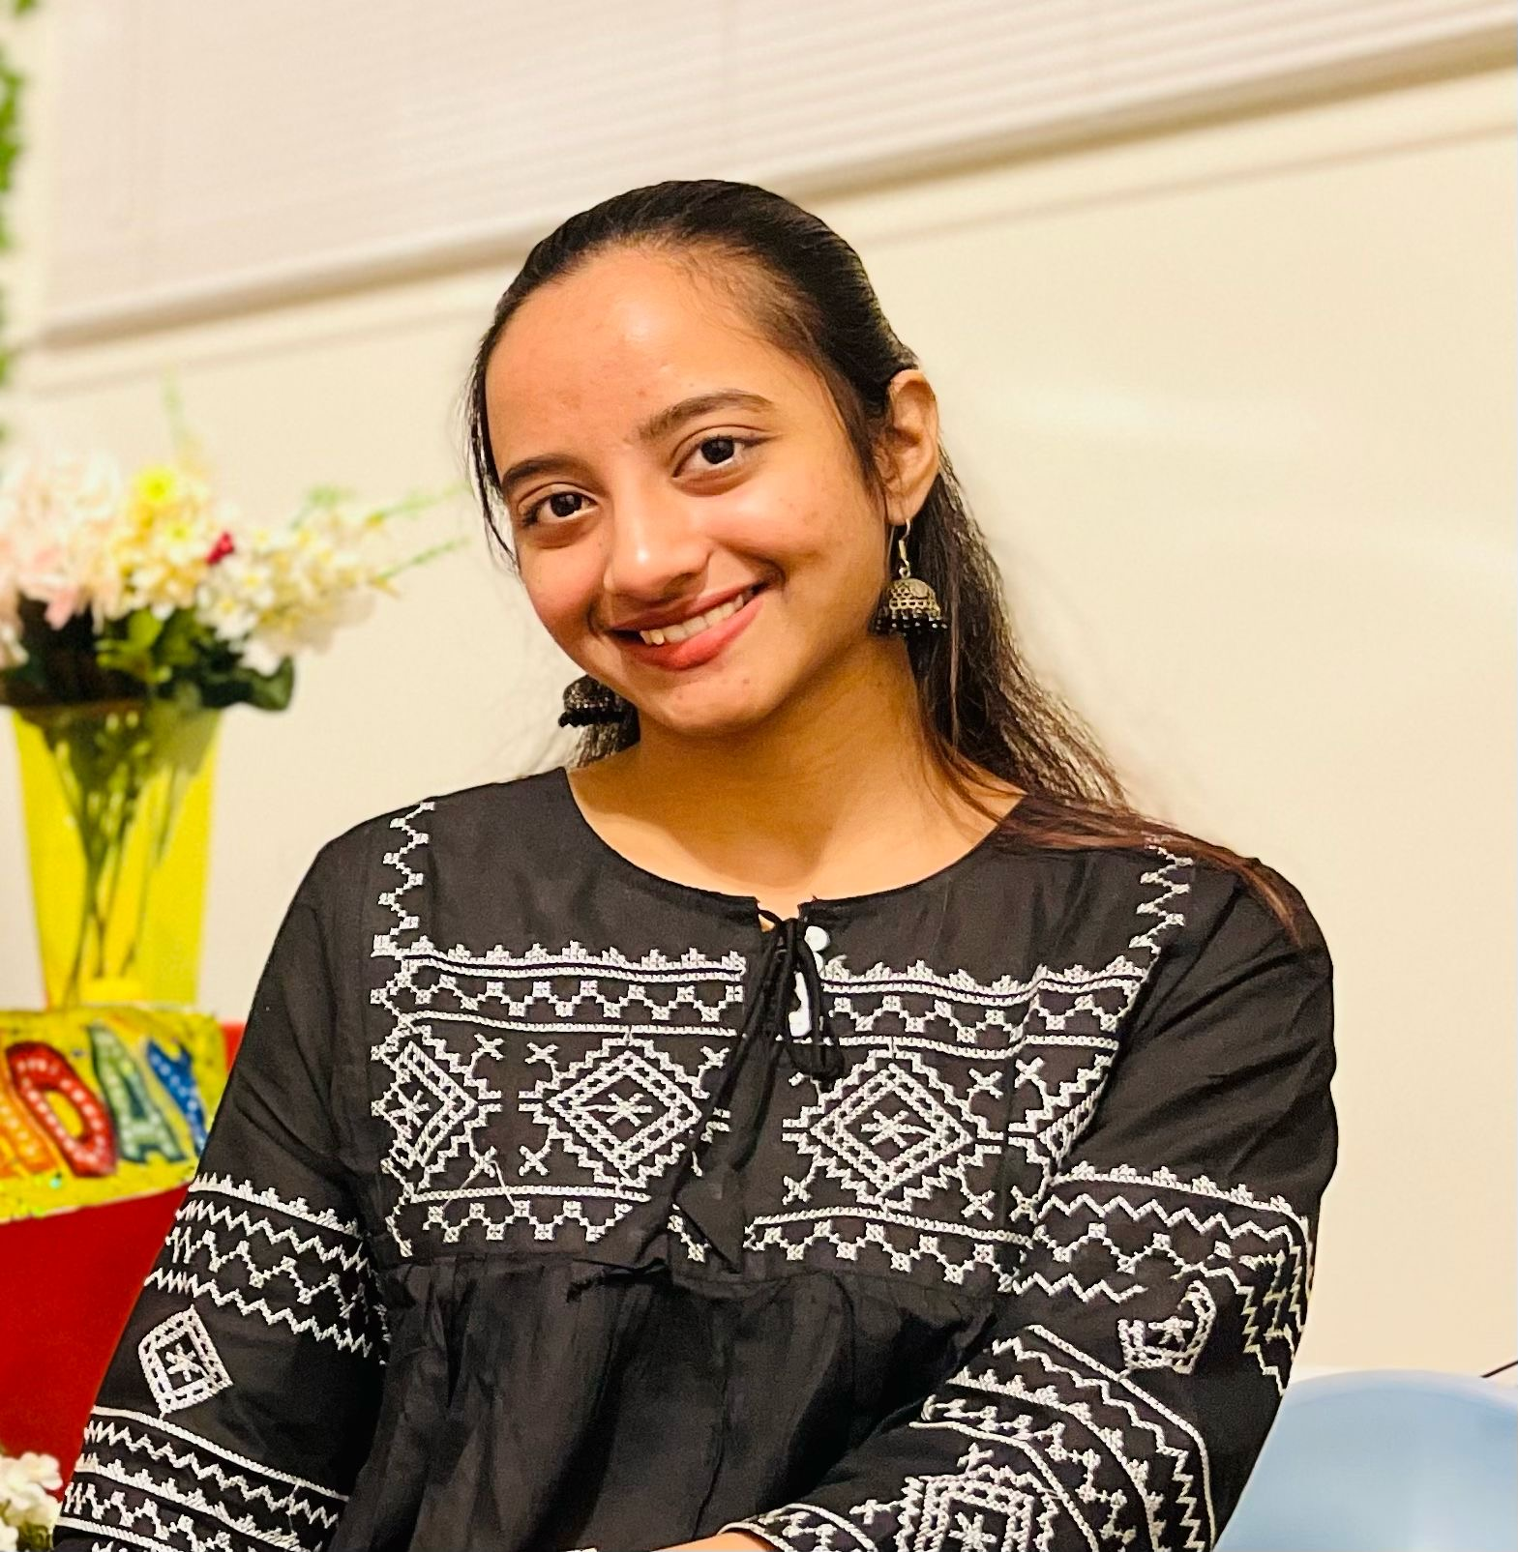

GDP Team- 3
Indu Chinthakuntla
Himaja Reddy Maddi
Pavan Kumar Koppuravuri
Satya Tummala
Apurupa Mathi

Slide 3
OUTLINE
INTRODUCTION
FUNCTIONAL/NON-FUNCTIONAL REQUIREMENTS
GUI
DATA FLOW DIAGRAM
IMPLEMENTATION
ER DIAGRAM
SUMMARY

Slide 4
INTRODUCTION
In our day-to-day life we consume food, and our survival is predicated on mainly food.
A considerable amount of our food is coming from farms and other means too.
By this project we will be able to connect farmers directly to the customer so that direct dealing of products can be accomplished.

Slide 5
INTRODUCTION
We are going to develop e-farming application that fulfill all needs of the farmer and give the solution.
The reason to establish a direct farmer-to-consumer marketing outlet is primarily to increase your financial returns from farm production.

Slide 6
FUNCTIONAL REQUIREMENTS
User:
If the user login for the first time they need to signup and provide their details.
This application allows users to log into their account by entering their username and password.
The application allows users to reset their password.

Slide 7
FUNCTIONAL REQUIREMENTS
Dealer/Farmer:
In this application dealer/farmer can add and remove product from the page
Dealer can buy farmer products; farmer can buy dealer products and sell their products to the user.

Slide 8
FUNCTIONAL REQUIREMENTS
Customer:
This application allows customer to buy farmer products.
Customer can add and remove one or more products from his cart.

Slide 9
FUNCTIONAL REQUIREMENTS
Order Cart:
User can select items which he wanted to purchase from the list of items provided in the application.
User can add the selected items to cart and select the quantity based on user's requirement.

Slide 10
FUNCTIONAL REQUIREMENTS
Payment:
User can make a payment through different modes of payment.
After payment user will get a notification about the payment.
Order History:
The details of the purchases are stored here.
User will be able to view the history of earlier purchases.

Slide 11
FUNCTIONAL REQUIREMENTS
Admin:
Admin can access all kinds of users.
Admin will have all the rights to make any changes related to the application.
Common Functionalities:
User can get assistance about the usage of app through help and support page.
User will be able to view and update details.

Slide 12
NON-FUNCTIONAL REQUIREMENTS
Usability
Reliability
Security
Maintainability
Effectiveness
Availability

Slide 13
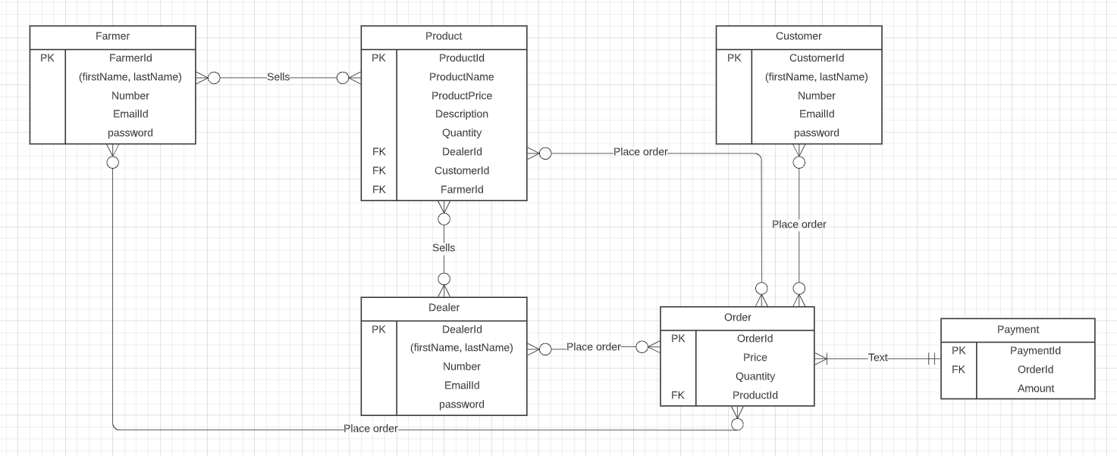
ER DIAGRAM

Slide 14
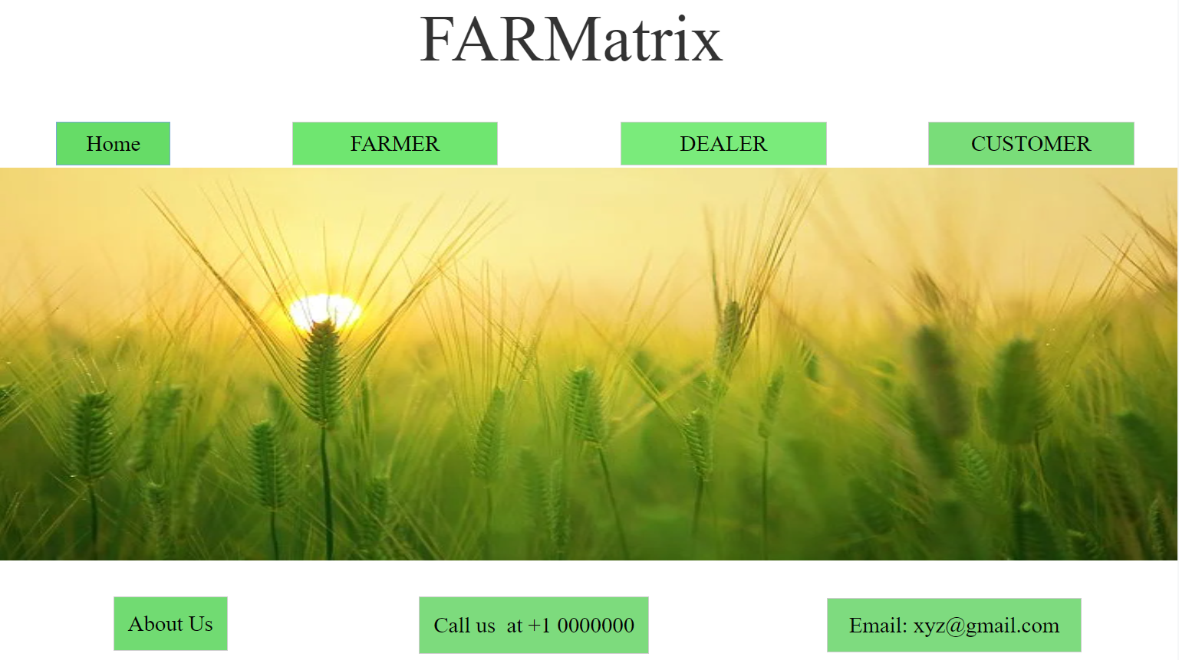
GRAPHICAL USER INTERFACE(GUI) Home Page

Slide 15
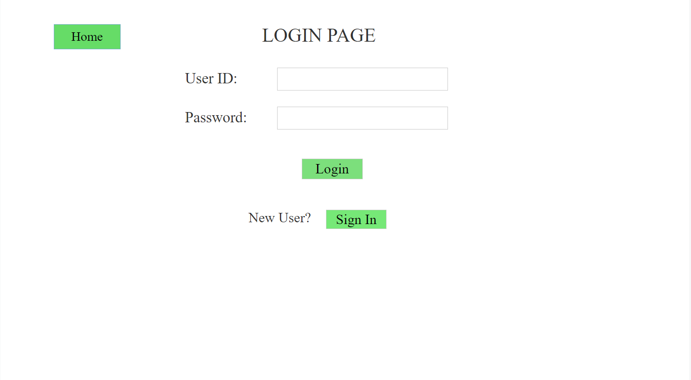
LOGIN PAGE

Slide 16
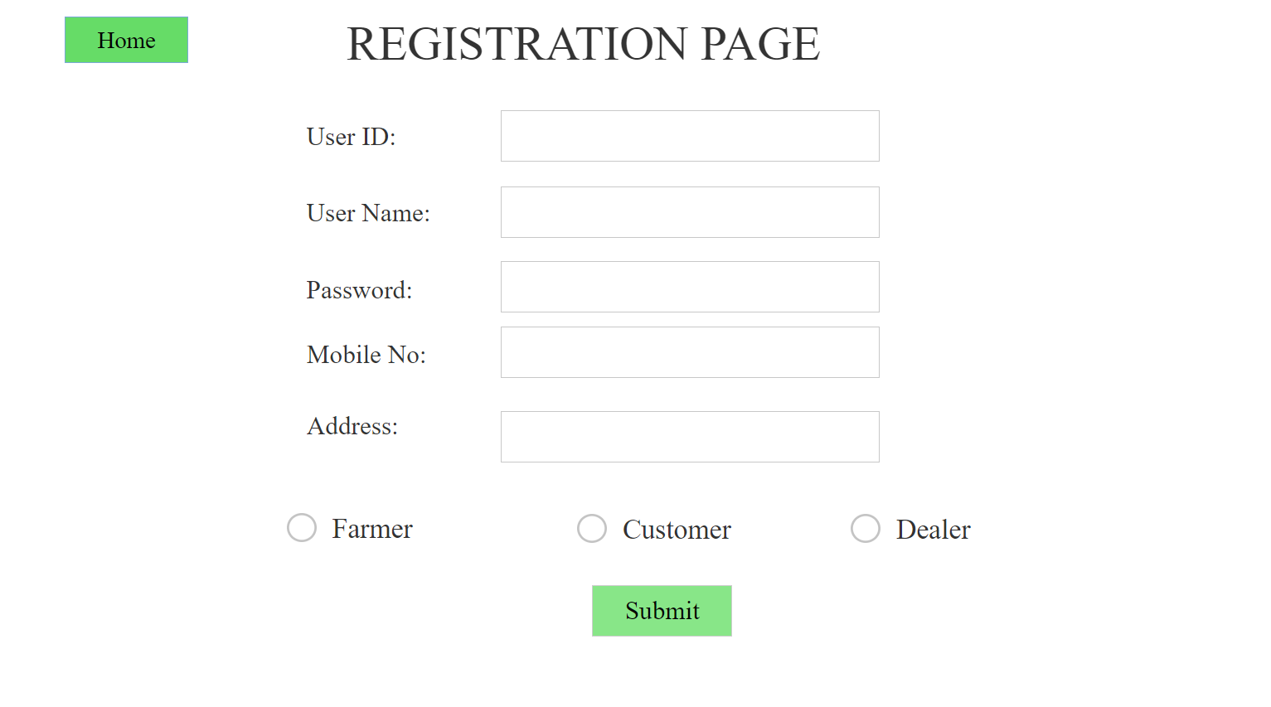
REGISTRATION PAGE

Slide 17
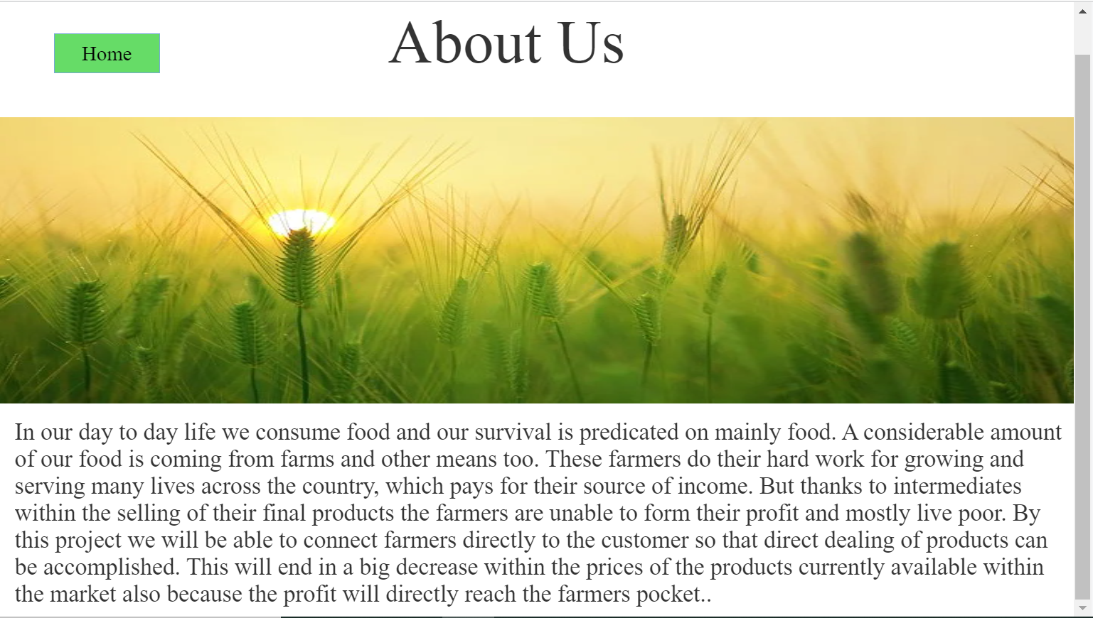
ABOUT US PAGE

Slide 18
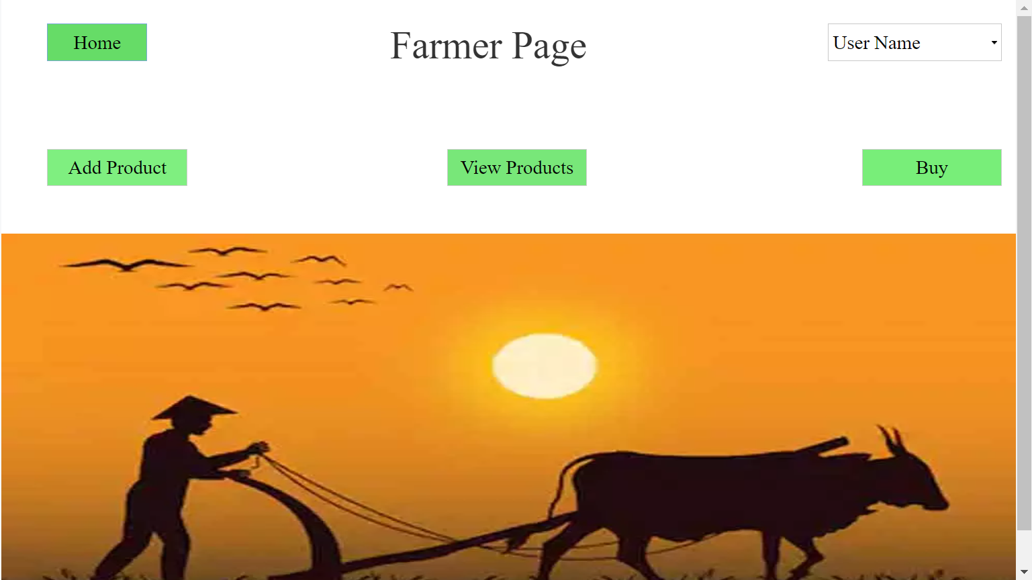
FARMER PAGE
Pavan Kumar Koppuravuri

Slide 19
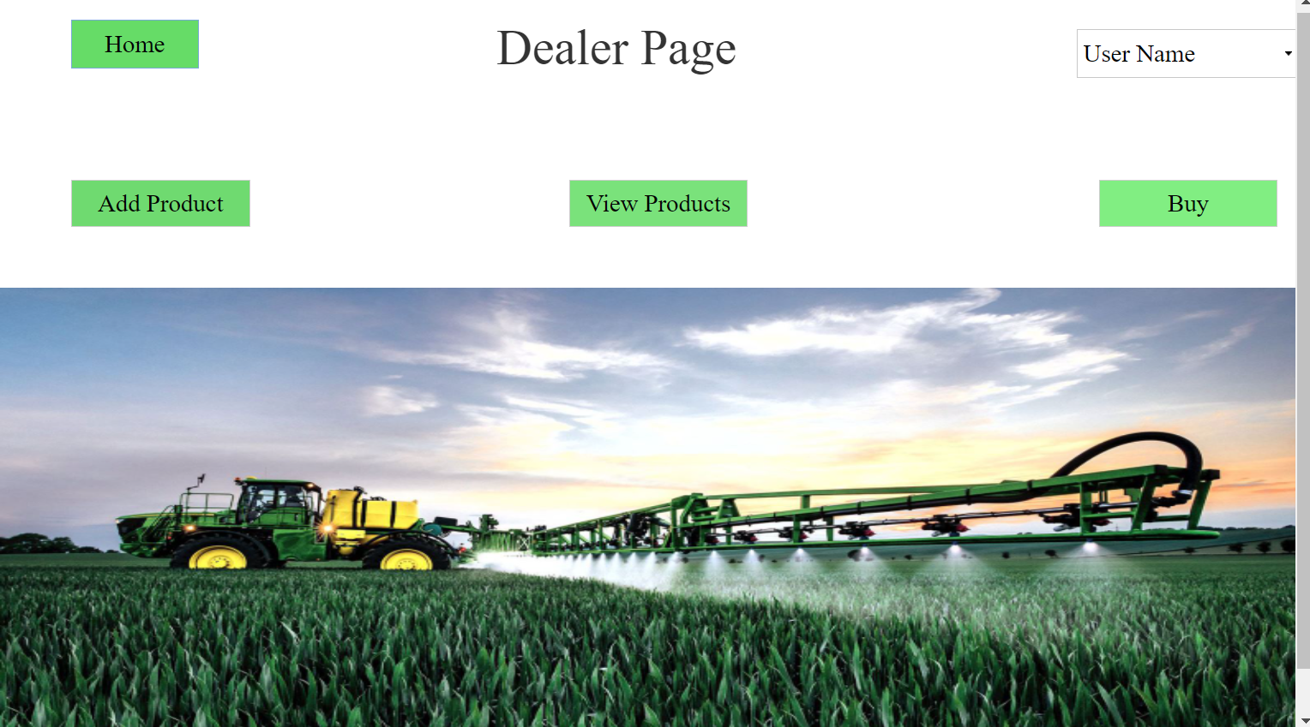
DEALER PAGE
Pavan Kumar Koppuravuri

Slide 20
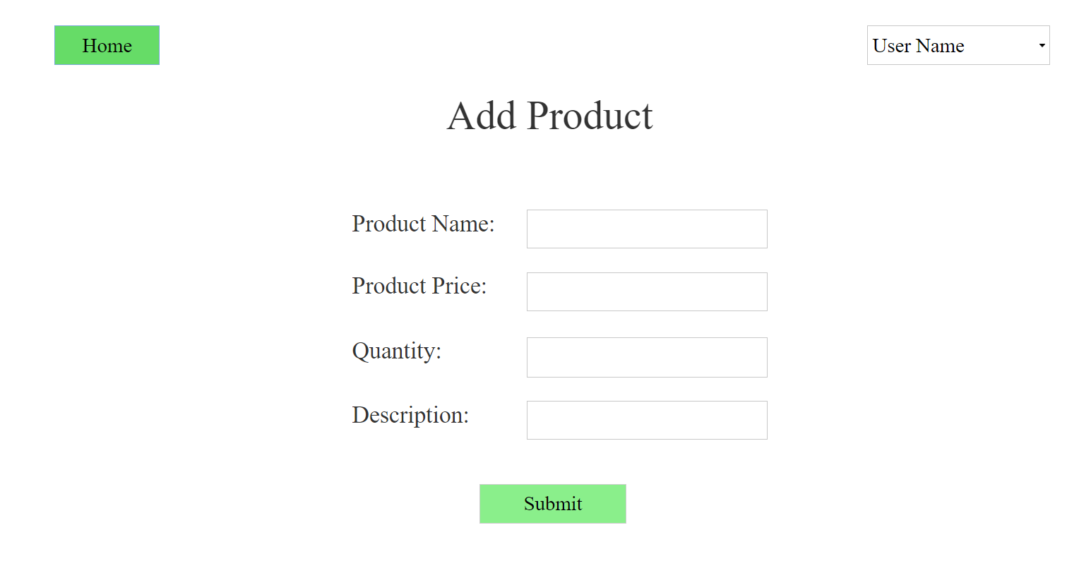
ADD PRODUCT PAGE
Pavan Kumar Koppuravuri

Slide 21
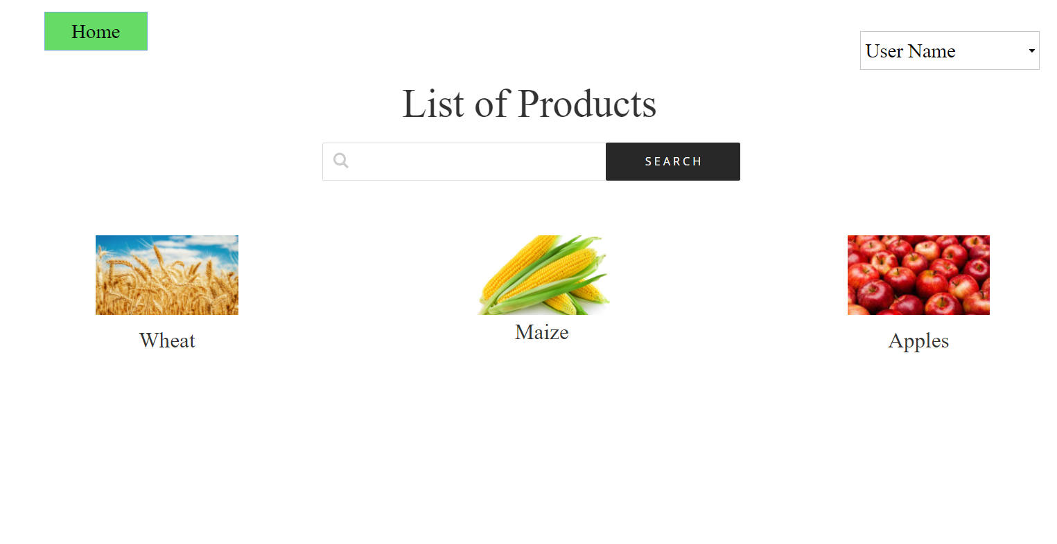
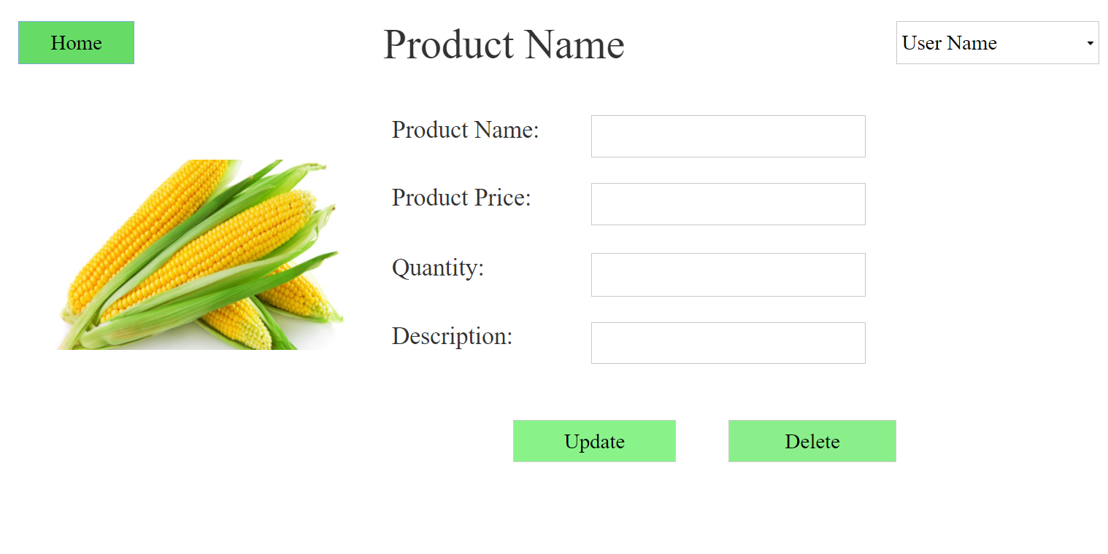
LIST OF PRODUCTS PAGE
Pavan Kumar Koppuravuri

Slide 22
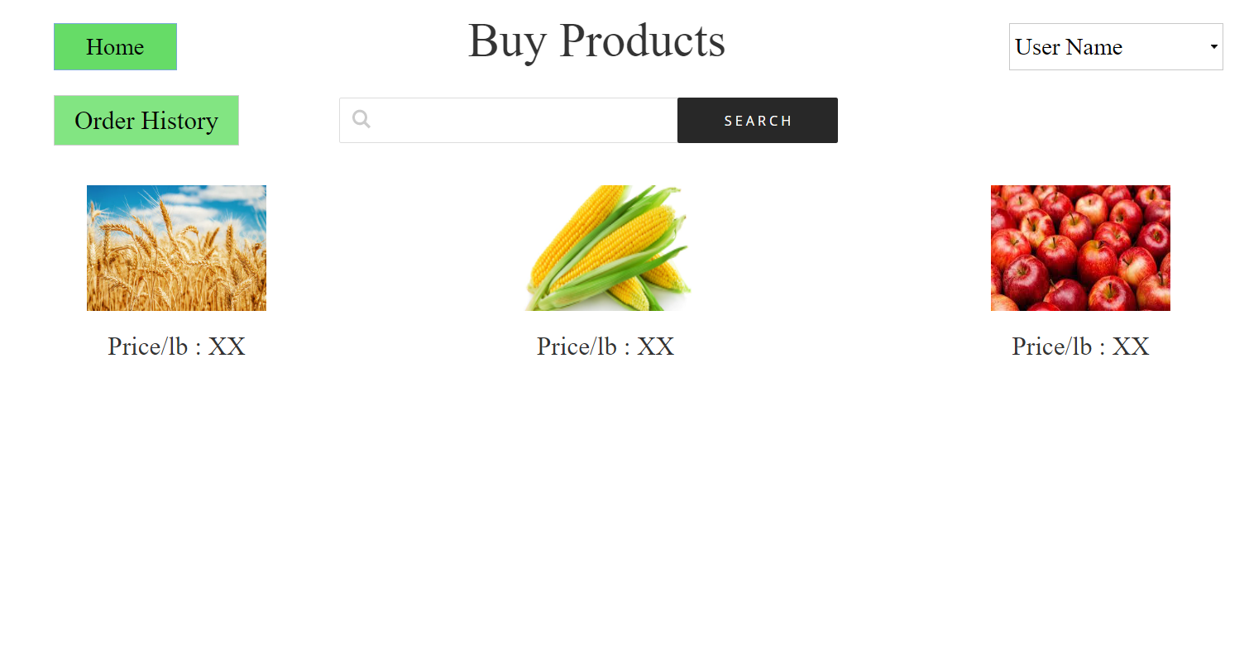
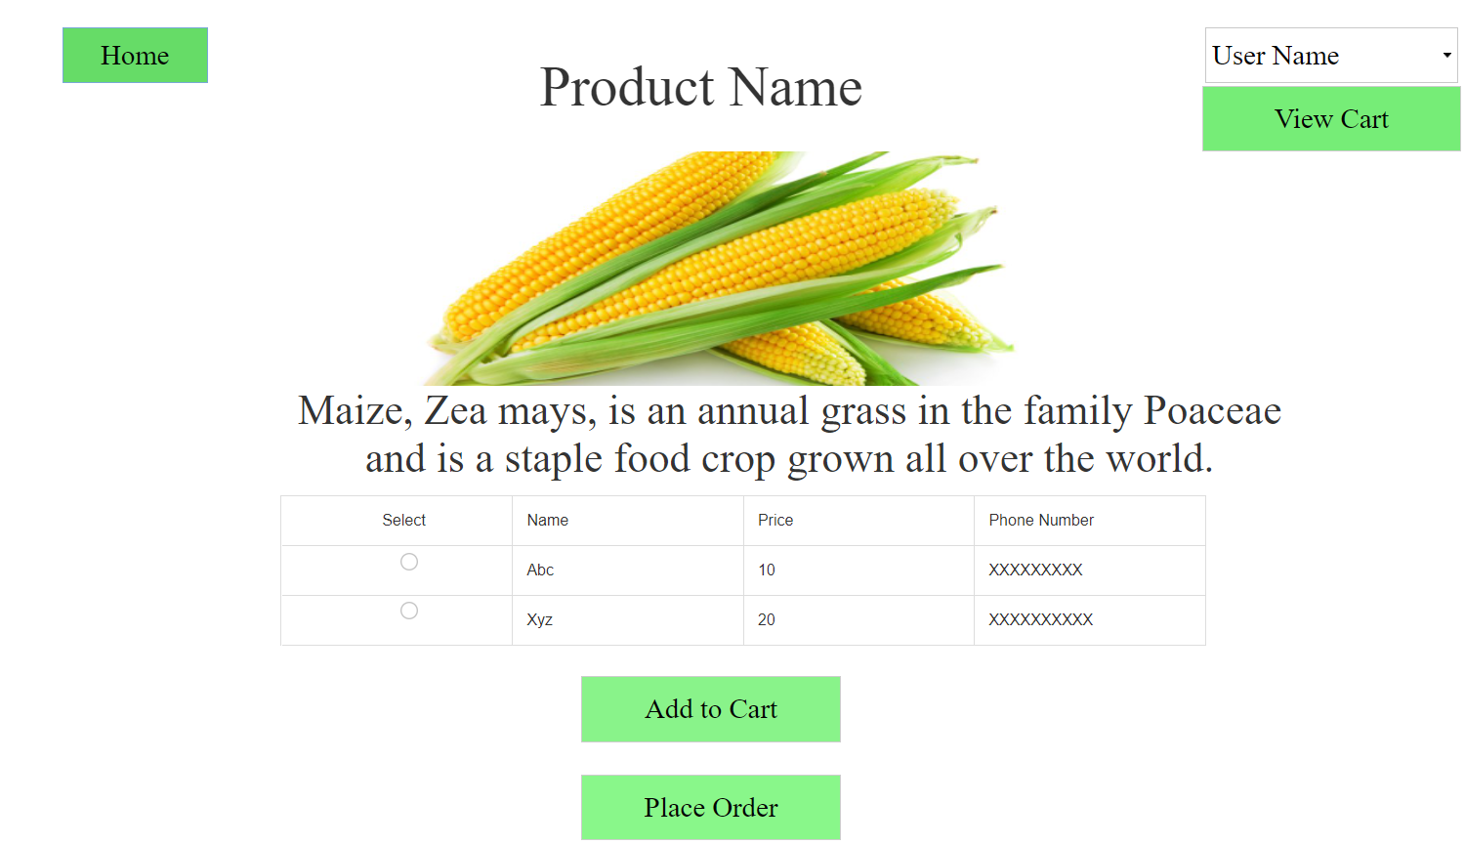
BUY PRODUCTS PAGE
Pavan Kumar Koppuravuri

Slide 23
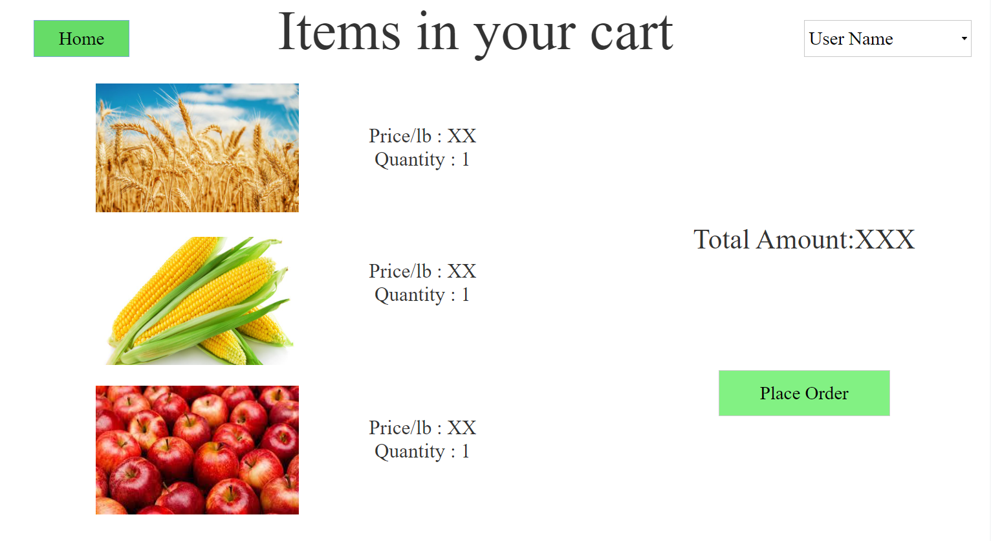
CART PAGE
Pavan Kumar Koppuravuri

Slide 24
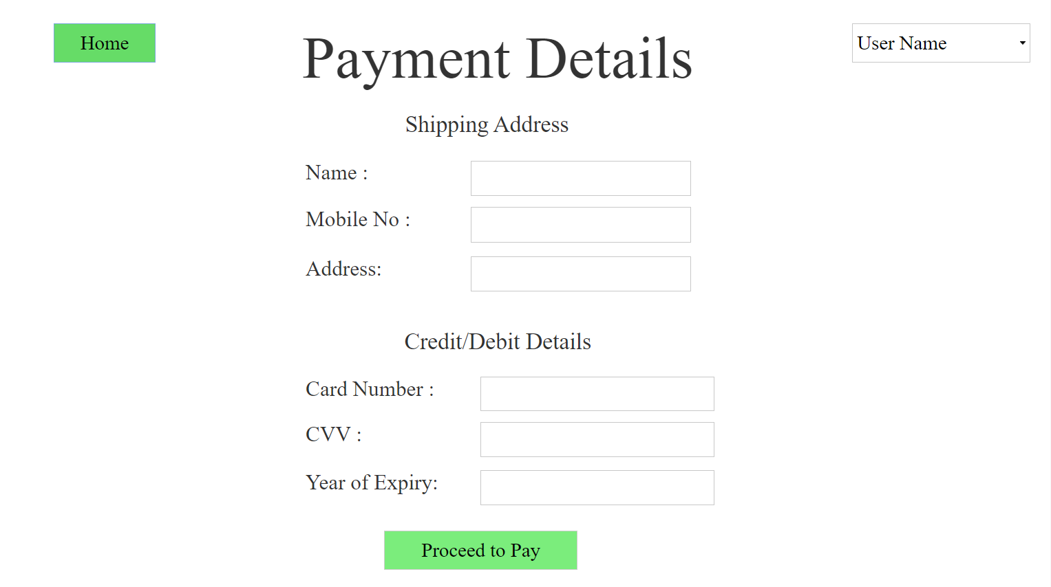
PAYMENT PAGE
Pavan Kumar Koppuravuri

Slide 25
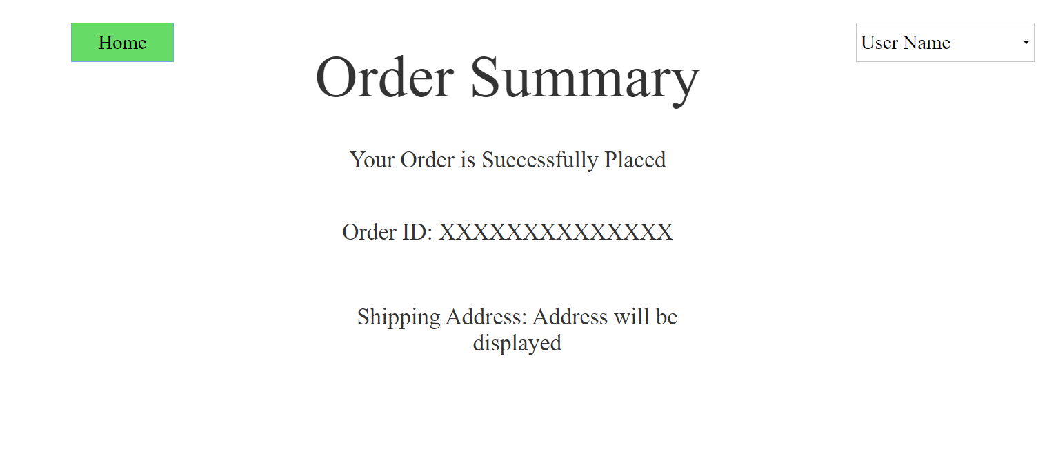
ORDER SUMMARY PAGE
Pavan Kumar Koppuravuri

Slide 26
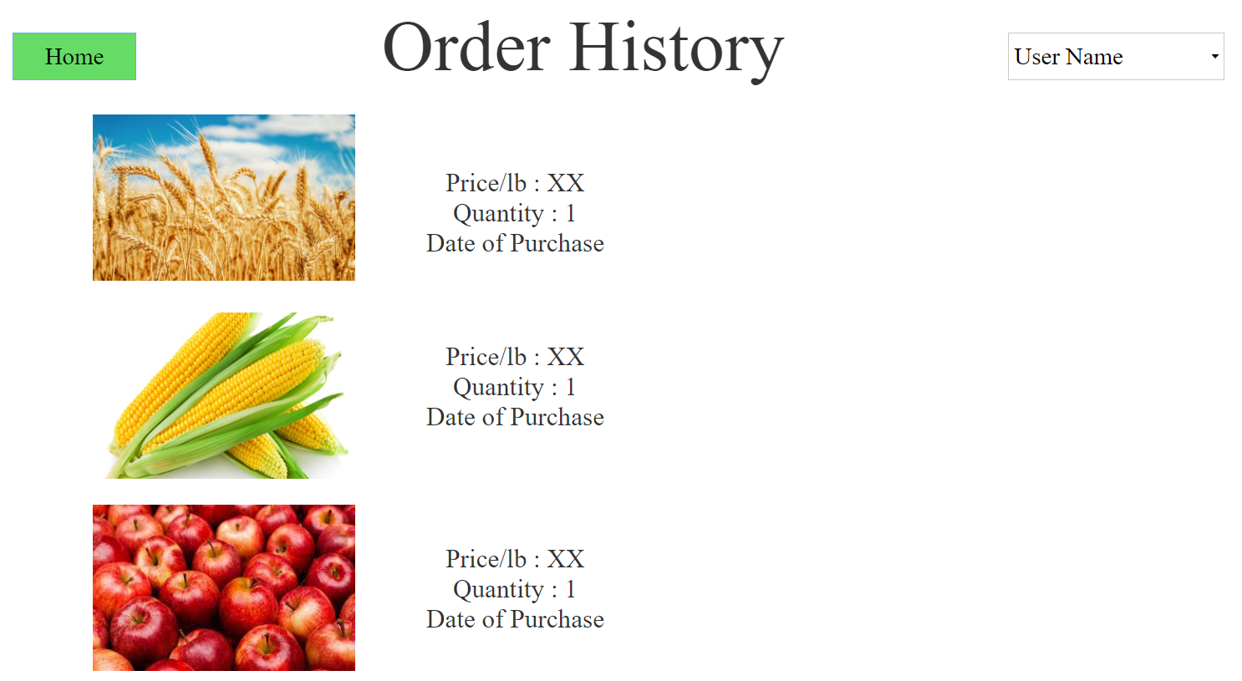
ORDER HISTORY PAGE
Pavan Kumar Koppuravuri

Slide 27
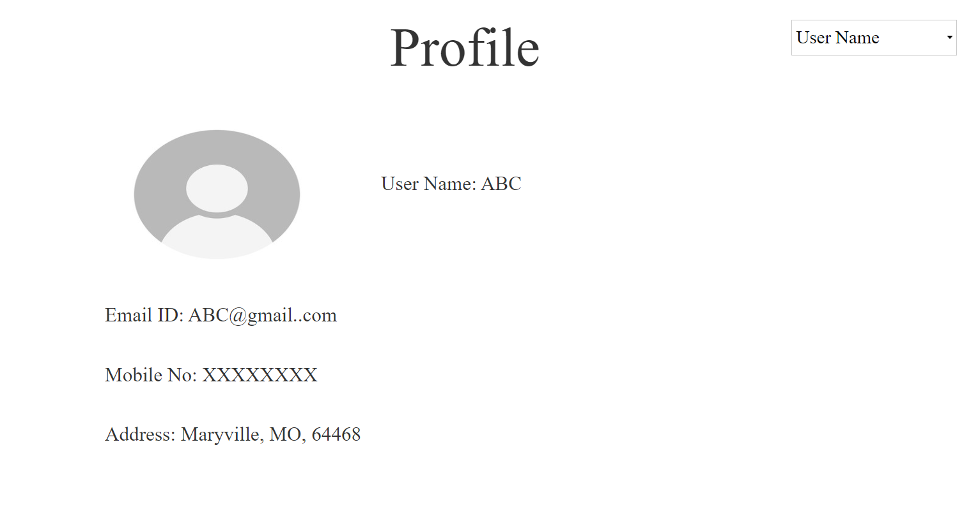
PROFILE PAGE
Pavan Kumar Koppuravuri

Slide 28
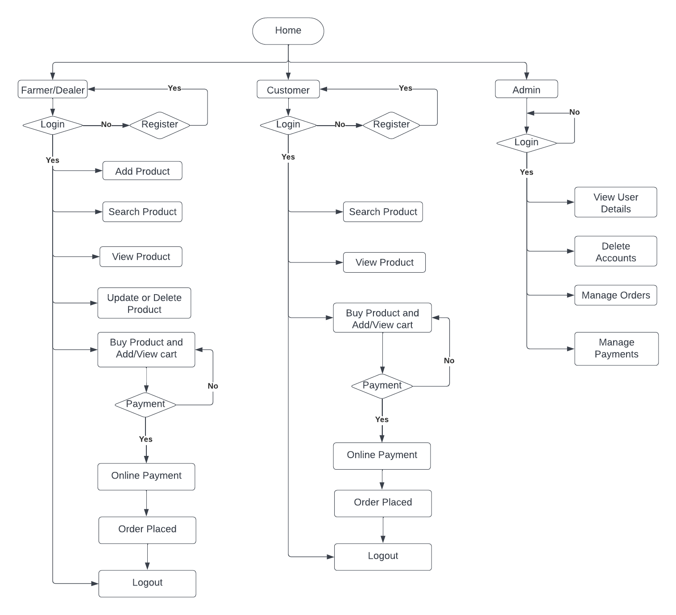
DATA FLOW DIAGRAM

Slide 29
IMPLEMENTATION
Front End : HTML, CSS, JavaScript, Angular / ReactJS
Back End: Java Using Spring Boot or iOS
Database : MySQL
Deployment using Heroku

Slide 30
SUMMARY
By the help of this application people will be able to get fresh food to eat.
This application will help both the farmer and the customer, where the customer can save some money and the farmer will gain extra profit deserved.

Slide 31

QUESTIONS?
Indu Chinthakuntla
Himaja Reddy Maddi
Pavan Kumar Koppuravuri
Satya Tummala
Apurupa Mathi

Slide 32
THANK YOU

